Slide 1

PRESTIGE INSTITUTE OF ENGINEERING MANAGEMENT AND RESEARCH, INDORE
THE
TRANSFER
VILLAGE
UNDER THE GUIDANCE OF PROF. MONIKA VERMA

Slide 2
THE TEAM
Navalkhe Tejas
Kshitij Ovhal
Noorvi Patankar
Prachi Rai
3

Slide 3
CONTENT
Problem Statement
Objective
Planning
Flow Diagram
Tools & Technology Used
3

Slide 4
PROBLEM STATEMENT
Nowadays, because of the growing industry, data generation speed is very high. As there are a lot of data, the data needs to be shared for any business purpose. But the main problem while sharing files is.
1. Security – Many files include sensitive data, so sharing them directly can cause expose sensitive business data.
2. File Size – Even Gmail allow for file sharing of approximately 25 MB of attachment per mail, so sending a large file is difficult.
3. File Format – For sharing a word file as a pdf, the first file needs to be converted to pdf, which is a very time-consuming task.

Slide 5

OBJECTIVE
Security
File Size
The files can be password protected. Users can opt-in for an option to add the password.
Using Gmail only up to approximately 25 MB files can be shared, using Transfer Village more than 25 MB files can be shared.
File Format
Using Transfer Village, you can convert the word file to pdf on-the-fly and directly share it.
Notes:
5. Planning Left

Slide 6
WORKING
1. The new user will register and login on to the website.
2. User will upload a file with options to choose from like whether he/she wants to make a file password protected or not. Whether he/she wants to expire the link for the file?
3. Once everything is uploaded, a unique link will be shown for sharing.
4.The user will share that link.

Slide 7
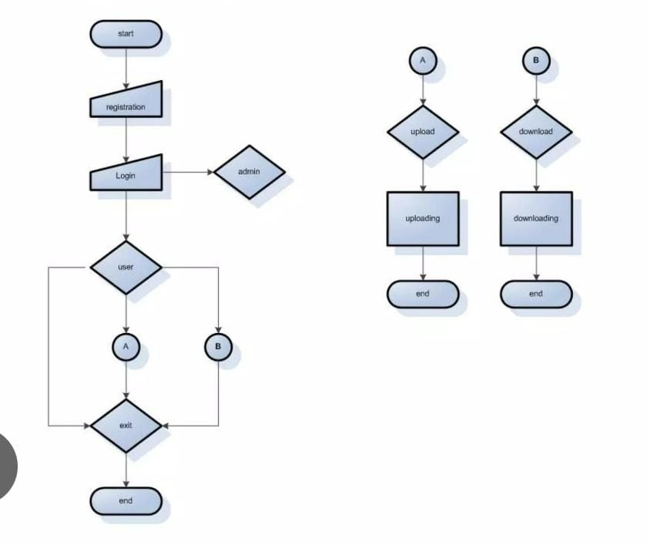
FLOW DIAGRAM

Slide 8





HTML
CSS
HTML – HTML stands for Hyper Text Markup Language. HTML is the standard markup language for creating Web pages. HTML elements tell the browser how to display the content.
CSS stands for Cascading Style Sheets. CSS describes how HTML elements are to be displayed on screen, paper, or in other media. CSS saves a lot of work. It can control the layout of multiple web pages all at once.
TECHNOLOGY
USED
Python
Flask
Python is an interpreted, object-oriented, high-level programming language with dynamic semantics. It’s high-level built-in data structures, combined with dynamic typing and dynamic binding, make it very attractive for Rapid Application Development
Flask is a web framework, it’s a Python module that lets you develop web-based applications easily. It has a small and easy-to-extend core: It’s a microframework that doesn’t include ORM (Object Relational Manager) or such features

Slide 9


Javascript
JavaScript is the world's most popular programming language. JavaScript is the programming language of the Web. JavaScript is easy to learn. JavaScript is used to program the behaviour of Web pages.
TECHNOLOGY
USED
Object Storage
Object storage, also known as object-based storage, is a computer data storage architecture designed to handle large amounts of unstructured data.

Slide 10
THANK
YOU

